Slide 1
The Elasticity of Investment with respect to the User Cost of Capital
Dr. Sebastian James, World Bank Group

Slide 2
Background
How does investment respond to changes in corporate tax parameters (laws, depreciation allowances, incentives, etc.)?
Key variable: the tax-adjusted user cost of capital [Jorgenson (1963), Hall and Jorgenson (1967) ]
The tax code influences how costly capital is for a particular company

Slide 3
Background
Firm-level data, repeated yearly observations, large sample sizes.
Empirical evidence mostly comes from Europe and the US
Authors | Countries | Firms and years | Elasticity
Chirinko, Fazzari and Meyer (1999) | US | 4,900 firms (1981-1991) | -0.25
Bond and Xing (2013) | 7 European countries | 42,406 firms (1999-2007) | -0.98 to -1.7
Dwenger (2014) | Germany | 3,968 firms (1997-2007) | -0.97 to -1.3
Notes:
Chirinko, Fazzari and Meyer (1999) also estimate the response to a hypothetical 10% investment tax credit across the board and found that it would reduce the user cost by 14.25% and increase the capital stock by 3.5%.

Slide 4
Steps
Calculate the tax-adjusted user cost of capital for each company
Find out, empirically, the response of investment to changes in the user cost
Simulate, on average, what would happen if some tax parameters change

Slide 5
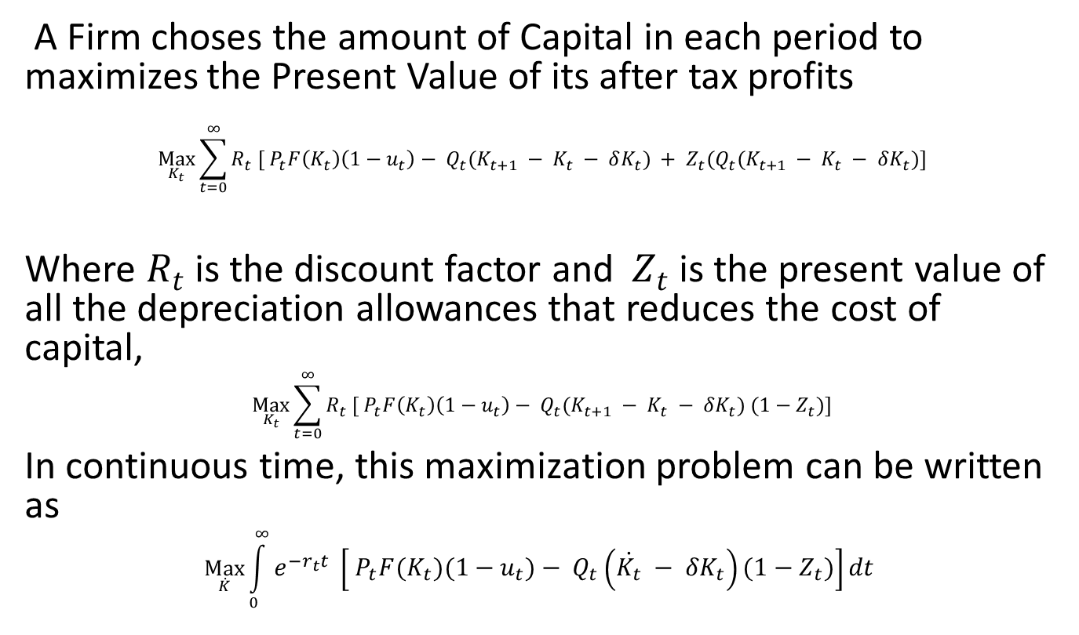
Firm Optimization Problem
A Firm choses the amount of Capital in each period to maximizes the Present Value of its after tax profits
$$\underset{K_{t}}{Max}{\sum_{t=0}^{∞}{R_{t} [ P_{t}F\left(K_{t}\right)\left(1−u_{t}\right)− Q_{t}(K_{t+1} − K_{t} − δK_{t}}) + Z_{t}(Q_{t}(K_{t+1} − K_{t} − δK_{t})]}$$
Where $R_{t}$ is the discount factor and $Z_{t}$ is the present value of all the depreciation allowances that reduces the cost of capital,
$$\underset{K_{t}}{Max}{\sum_{t=0}^{∞}{R_{t} [ P_{t}F\left(K_{t}\right)\left(1−u_{t}\right)− Q_{t}(K_{t+1} − K_{t} − δK_{t}}) (1−Z_{t})]}$$
In continuous time, this maximization problem can be written as
$$\underset{\dot{K}}{Max}{\int_{0}^{∞}{e^{−r_{t}t} \left[ P_{t}F\left(K_{t}\right)\left(1−u_{t}\right)− Q_{t}\left(\dot{K_{t}} − {δK}_{t}\right)\left(1−Z_{t}\right)\right]dt }}$$

Slide 6
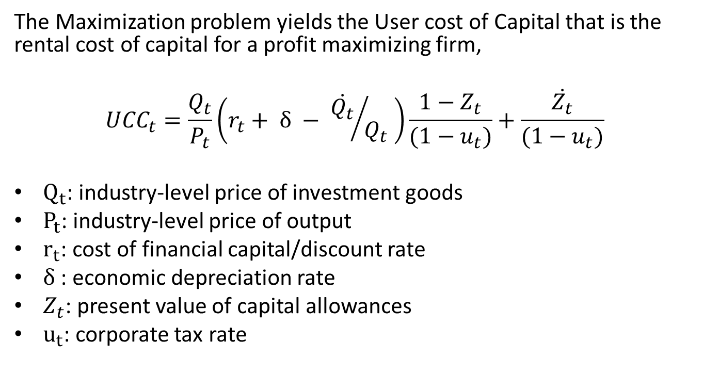
User Cost of Capital Formula
The Maximization problem yields the User cost of Capital that is the rental cost of capital for a profit maximizing firm,
$${UCC}_{t}=\frac{Q_{t}}{P_{t}}\left(r_{t}+ δ − {\dot{Q_{t}}}/{Q_{t}} \right)\frac{1−Z_{t}}{(1−u_{t})}+\frac{\dot{Z_{t}}}{(1−u_{t})}$$
$Q_{t}$: industry-level price of investment goods
$P_{t}$: industry-level price of output
$r_{t}$: cost of financial capital/discount rate
$δ$: economic depreciation rate
$Z_{t}$: present value of capital allowances
$u_{t}$: corporate tax rate

Slide 7
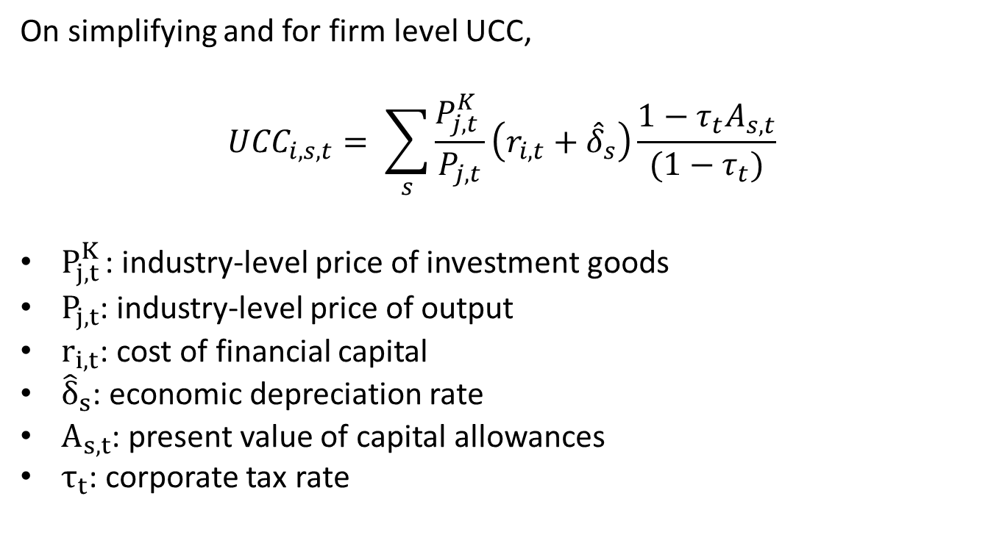
User Cost of Capital Formula
On simplifying and for firm level UCC,
$${UCC}_{i,s,t}= \sum_{s}{\frac{P_{j,t }^{K}}{P_{j,t}}\left(r_{i,t}+{\hat{δ}}_{s}\right)\frac{1−τ_{t}A_{s,t}}{(1−τ_{t})}}$$
$P_{j,t }^{K}$: industry-level price of investment goods
$P_{j,t}$: industry-level price of output
$r_{i,t}$: cost of financial capital
${\hat{δ}}_{s}$: economic depreciation rate
$A_{s,t}$: present value of capital allowances
$τ_{t}$: corporate tax rate

Slide 8

UCC aggregated at the company level
$${UCC}_{i,t}= \sum_{s}{w_{i,s,t}} {UCC}_{i,s,t}$$
SNAISIC_A38 | MV | MACH | L&B | OTH
Accommodation and food services activities | 0.3 | 2.1 | 77.6 | 19.9
Agriculture, forestry and fishing | 2.0 | 5.1 | 57.1 | 35.8
Education | 2.0 | 5.6 | 65.2 | 27.3
Human health and social work activities | 4.6 | 12.4 | 49.0 | 34.0
Manufacture of basic metals and fabricated metal products | 1.8 | 44.5 | 38.7 | 15.0
Manufacture of chemical products & pharmaceuticals | 0.8 | 58.2 | 22.6 | 18.4
Manufacture of coke, and refined petroleum products | 0.1 | 79.0 | 4.9 | 16.1
Manufacture of computer, electronic and optical products | 0.3 | 54.6 | 29.8 | 15.3
Manufacture of electrical equipment | 1.8 | 37.7 | 44.9 | 15.6
Manufacture of food products, beverages and tobacco products | 1.9 | 31.2 | 44.3 | 22.5
Manufacture of machinery and equipment n.e.c | 2.8 | 32.9 | 48.8 | 15.5
Manufacture of rubber and plastics products | 2.5 | 46.9 | 37.7 | 12.9
Manufacture of textiles, apparel, leather and related products | 1.7 | 44.7 | 43.9 | 9.7
Manufacture of transport equipment | 1.8 | 33.4 | 44.9 | 19.9
Manufacture of wood and paper products, and printing | 2.3 | 45.6 | 39.2 | 12.9
Real estate and business/scientific activities | 5.2 | 7.6 | 30.0 | 57.2
Transportation, storage, information and communication | 7.8 | 29.5 | 19.5 | 43.1

Slide 9
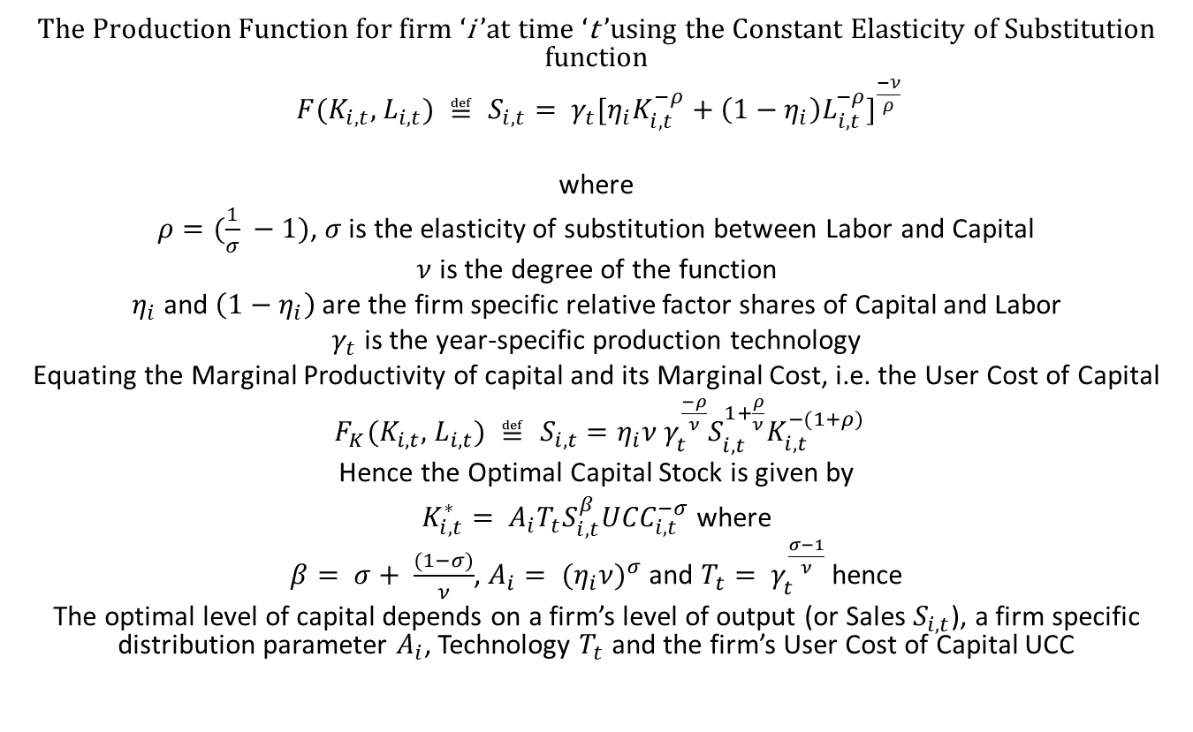
Arriving at the Time Series Specification from Firm optimization
The Production Function for firm ‘i ’at time ‘t ’using the Constant Elasticity of Substitution function
$F(K_{i,t},$ $L_{i,t}) ≝ S_{i,t}= {γ_{t}[η_{i}K_{i,t}^{−ρ}+\left(1−η_{i}\right)L_{i,t}^{−ρ}]}^{\frac{−ν}{ρ}}$
where
$ρ=(\frac{1}{σ} −1)$, $σ$ is the elasticity of substitution between Labor and Capital
$ν$ is the degree of the function
$η_{i}$ and $\left(1−η_{i}\right)$ are the firm specific relative factor shares of Capital and Labor
$γ_{t}$ is the year-specific production technology
Equating the Marginal Productivity of capital and its Marginal Cost, i.e. the User Cost of Capital
$F_{K}(K_{i,t},$ $L_{i,t}) ≝ S_{i,t}=η_{i}ν γ_{t}^{\frac{−ρ}{ν}}S_{i,t}^{1+\frac{ρ}{ν}}K_{i,t}^{−(1+ρ)}$
Hence the Optimal Capital Stock is given by
$K_{i,t}^{∗}= A_{i}T_{t}S_{i,t}^{β}{UCC}_{i,t}^{−σ}$ where
$β= σ+ \frac{(1−σ)}{ν}$, $A_{i}= {{(η}_{i}ν)}^{σ}$ and $T_{t}= γ_{t}^{\frac{σ−1}{ν}}$ hence
The optimal level of capital depends on a firm’s level of output (or Sales $S_{i,t}$), a firm specific distribution parameter $A_{i}$, Technology $T_{t}$ and the firm’s User Cost of Capital UCC

Slide 10
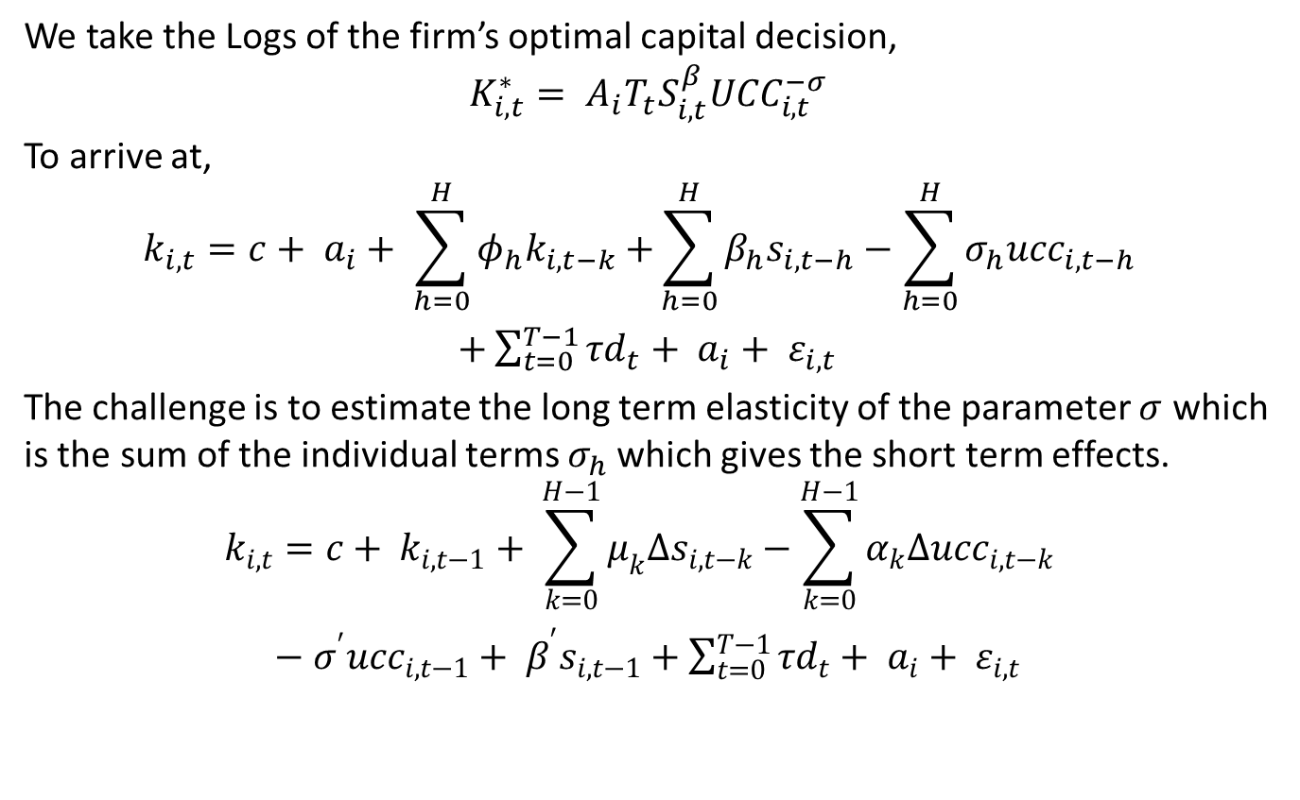
Time Series specification
We take the Logs of the firm’s optimal capital decision,
$$K_{i,t}^{∗}= A_{i}T_{t}S_{i,t}^{β}{UCC}_{i,t}^{−σ}$$
To arrive at,
$$k_{i,t}=c+ a_{i}+ \sum_{h=0}^{H}{φ_{h}k_{i,t−k}+}\sum_{h=0}^{H}{β_{h}s_{i,t−h}−\sum_{h=0}^{H}{σ_{h}{ucc}_{i,t−h} } }$$
$+\sum_{t=0}^{T−1}{τd_{t}+ a_{i}+ ε_{i,t} }$
The challenge is to estimate the long term elasticity of the parameter $σ$ which is the sum of the individual terms $σ_{h}$which gives the short term effects.
$$k_{i,t}=c+ k_{i,t−1}+ \sum_{k=0}^{H−1}{μ_{k}∆s_{i,t−k}−\sum_{k=0}^{H−1}{α_{k}∆{ucc}_{i,t−k} } }$$
$−$ $σ^{′}{ucc}_{i,t−1}+ β^{′}s_{i,t−1}+$ $\sum_{t=0}^{T−1}{τd_{t}+ a_{i}+ ε_{i,t} }$

Slide 11
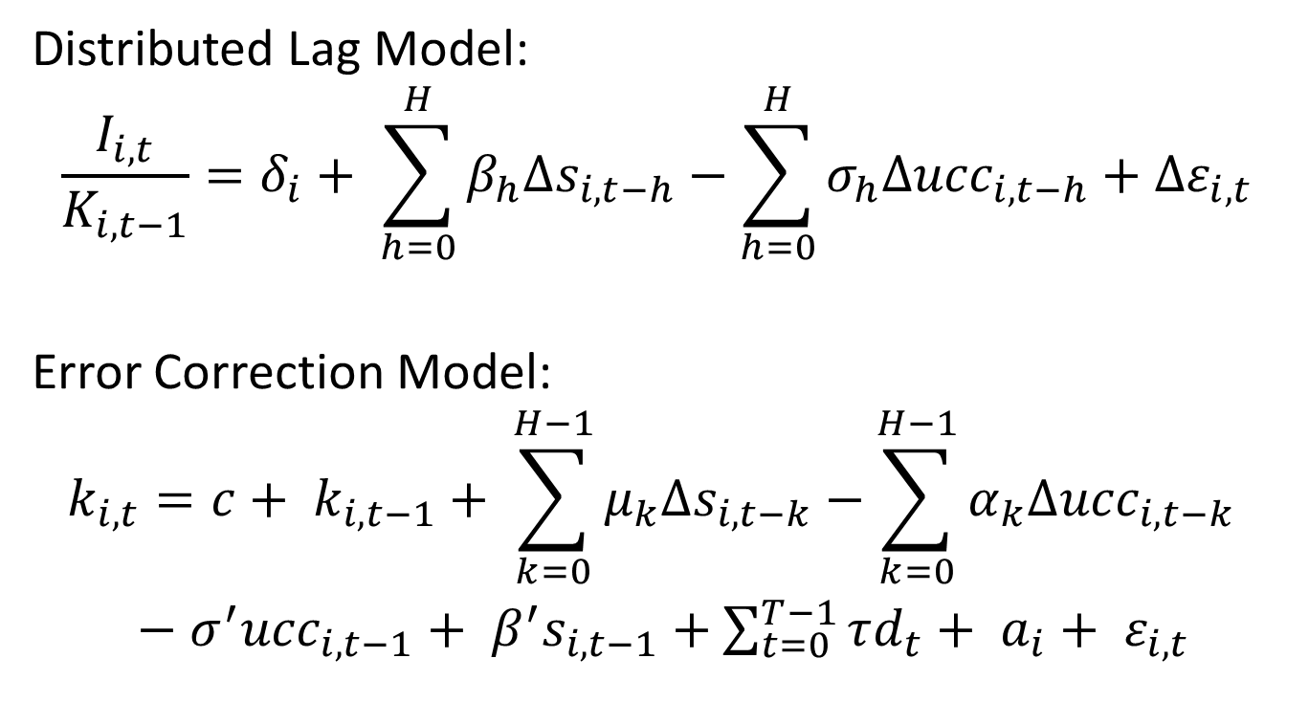
The DL model and the ECM model
Distributed Lag Model:
$$\frac{I_{i,t}}{K_{i,t−1}}=δ_{i}+ \sum_{h=0}^{H}{β_{h}∆s_{i,t−h}−\sum_{h=0}^{H}{σ_{h}∆{ucc}_{i,t−h}+{∆ε}_{i,t}} }$$
Error Correction Model:
$$k_{i,t}=c+ k_{i,t−1}+ \sum_{k=0}^{H−1}{μ_{k}∆s_{i,t−k}−\sum_{k=0}^{H−1}{α_{k}∆{ucc}_{i,t−k} } }$$
$−$ $σ^{′}{ucc}_{i,t−1}+ β^{′}s_{i,t−1}+$ $\sum_{t=0}^{T−1}{τd_{t}+ a_{i}+ ε_{i,t} }$

Slide 12
What is the effect of tax incentives on the user cost of capital?

Slide 13
What is the effect of tax incentives on the user cost of capital?

Slide 14
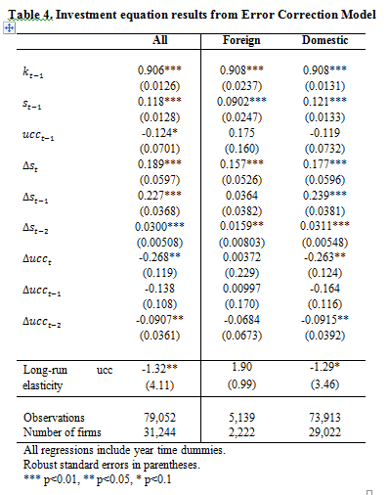
How does investment respond to changes in the user cost of capital?

Slide 15
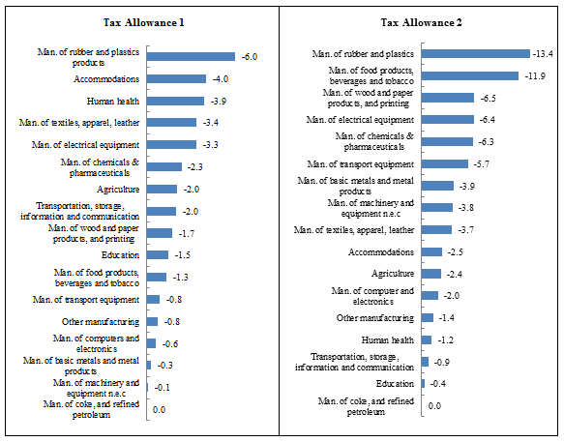
How would investment respond to a hypothetical change in tax incentives?

